Slide 1


Irevolution: Unveiling Market Insights: Analyzing Spending Behaviour and Opportunities for Growth
TEAM ID: NM2023TMID10011
III B.sc MATHEMATICS E/M
KALAIGNAR KARUNANIDHI GOVERNMENT ARTS COLLEGE FOR WOMEN (A),PUDUKKOTTAI - 622001

Slide 2
TEAM MEMBERS
TEAM LEADER:
P.Bharathi - bdu1621me1190
TEAM MATES :
R.Abinaya Vishnu Priya - bdu1621me1186
S.Bhavani - bdu1621me1191
M.Chandriya - bdu1621me1193
Notes:
1

Slide 3
INTRODUCTION
The project, titled “Unveiling Market Insights, “aimed to analyze spending behaviour and identify opportunities for growth through the use of Tableau. The primary objective was to gain a comprihensive understanding of consumer spending patterns, market trends, and potential growth areas. Leveraging Tableau’s powerful data visualization capabilities, we sought to transform raw data into actionable insights for strategic decision – making.

Slide 4
VISUALIZATIONS
A given dataset possesses the potential for a diverse array of distinctive visual representations. Various common visualization types, such as bar charts, line charts, heat maps, scatter plots, pie charts, maps, among others, are valuable tools for scrutinizing the performance and efficiency of a project. These visual tools serve multiple purposes, including performance comparison, temporal change tracking, and illustrating the distribution and relationships between different variables within the dataset

Slide 5
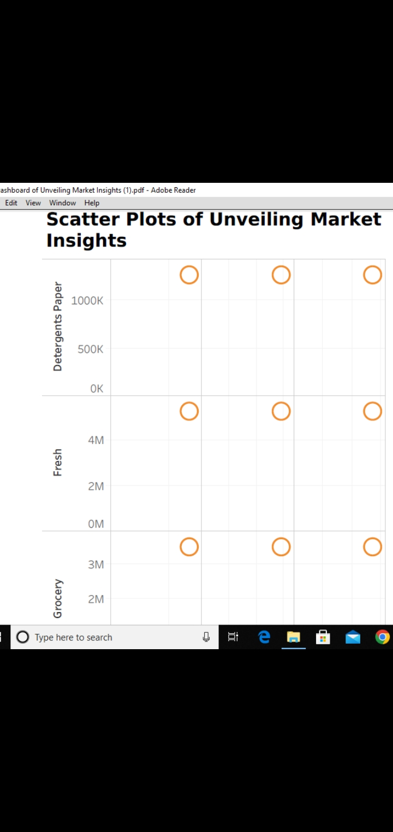
Dashboard 1

Slide 6
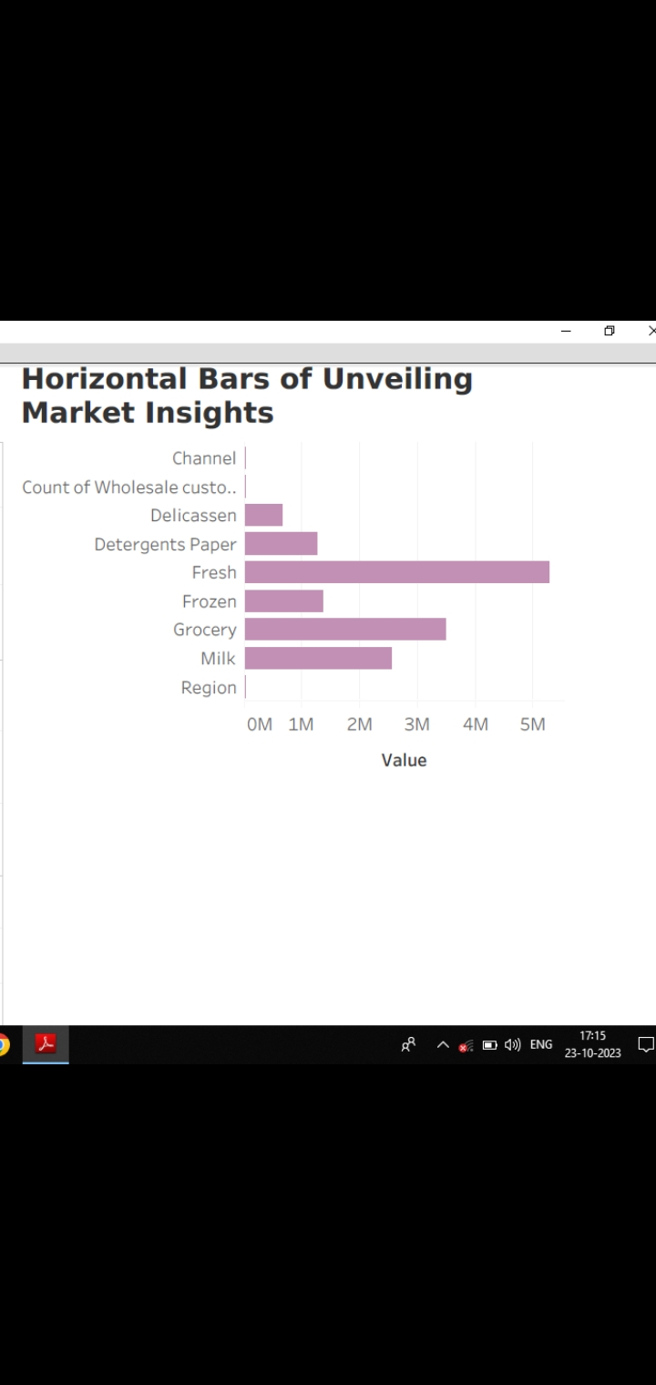
Dashboard 2

Slide 7
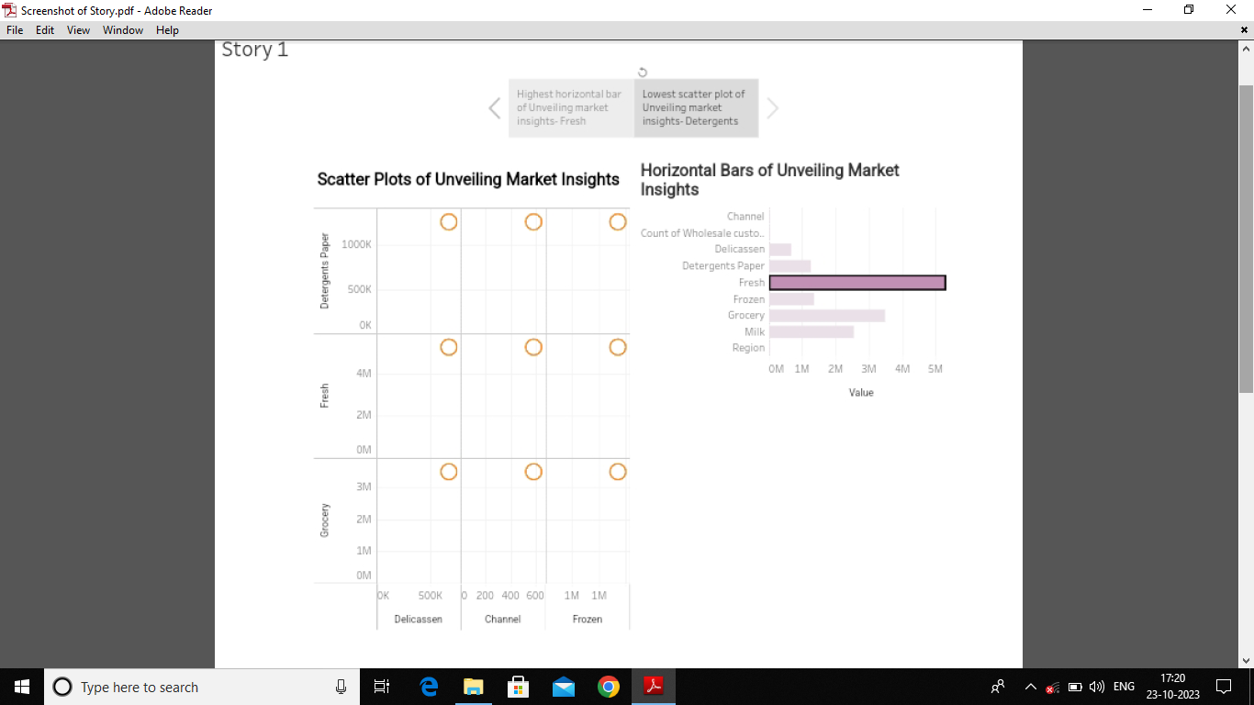
Story Board
Notes:
<number>

Slide 8
Conclusion
The “Unveiling Market Insights” project successfully utilized Tableau to analyze spending behaviour, identify opportunities for growth, and provide actionable insights for strategic decision making. The findings and recommendations outlined in this report serve as a valuable resource for stakeholders aiming to enhance market competitiveness and drive sustainable business growth.
This project underscores the importance of leveraging advanced analytics tools like Tableau to unlock the full potential of data, transforming it into a strategic asset for organizations in a rapidly evolving market landscape.

Slide 9
Future Scope
The future scope of Unveiling Market Insights using Tableau is likely to be characterized by advancements in Al, real-time analytics, data security, and imroved data experiences. As the field of data visualization and analytics continues to evolve, Tableau is poised to play a crucial role in empowering organizations with actionable insights for strategic decision-making.

Slide 10


